Slide 1
Stakeholders Workshop

Slide 2
Background
Global Estimates in 20XX (*red text entered by user throughout*),
XXM people developed TB
XXM were notified to national TB programs
XX% of global TB cases were missed by surveillance systems
(*country*) Estimates in 20XX
xxxxx people developed TB
xxxxx were notified to national programs
xxxxx were lab confirmed
xxxxx were initiated on treatment

Slide 3
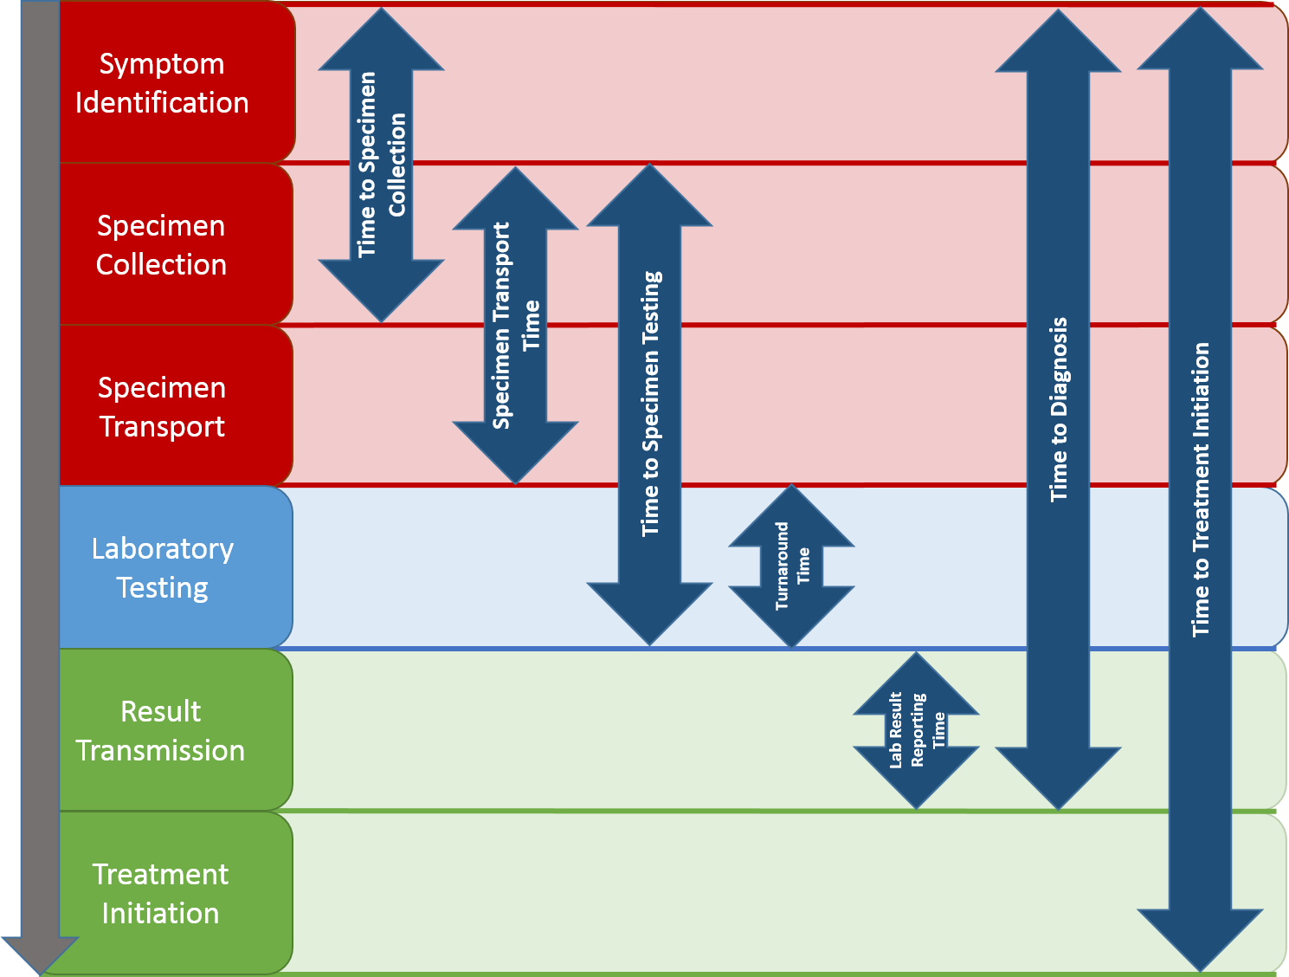
Justification
(Cascade Data are Often Missing or Incomplete for the Clinic-Lab Interface)
Cases Estimated
Cases Lab-Confirmed
Cases on Treatment
Cases Notified

Slide 4
Justification
(*Country*) ranks Xth in global TB infection, with reported gaps in case finding and treatment
The interface between clinics and lab services must be strengthened to optimize case finding and ensure all confirmed TB patients initiate appropriate treatment as quickly as possible
Persons that screen positive for TB must be efficiently linked to TB laboratory services
Persons that receive TB laboratory testing must receive accurate results quickly for clinical action

Slide 5
CLICQ! Proposed Goals
Diagnostic
Cascade
Improve TB case finding and initiation of TB Preventive Therapy or appropriate treatment initiation among HIV-positive and HIV-negative persons with presumptive or confirmed TB in
(*state, country*)
Improve time-to-TB diagnosis and time-to-TB therapy or treatment among HIV-positive and HIV-negative persons with presumptive or confirmed TB in (*state, country*)

Slide 6
CLICQ! Proposed Objectives
Diagnostic
Cascade
Increase the number and proportion of HIV-positive and HIV-negative persons with presumptive TB that receive TB laboratory services and accurate test results in a timely manner
Increase the number and proportion of HIV-positive and HIV-negative TB patients that initiate appropriate (drug-sensitive or drug-resistant) TB treatment
Increase the number and proportion of HIV-positive persons that are confirmed to be without TB disease that initiate TB Preventive Therapy
Reduce turnaround times associated with laboratory-confirmation of TB disease and initiation of appropriate TB therapy and treatment

Slide 7
Proposed Program Design
Part One
Pre-CLICQ! Activities
Part Two
DiCE Entry Assessments
Part Three
CLICQ! Implementation
Part Four
Part Five
DiCE Follow-up Assessments
Final Analysis and Writing Workshop

Slide 8
Overview of CLICQ! Learning Sessions
DiCE Entry Assessments | Learning Session 1 |  | Learning Session 2
Facility Tour Data Abstraction Data Entry Data Analysis Site Report Writing Site Debrief | TB CLICQ! Overview CQI Overview Process Mapping Overview Process map activity Walk the process Update process maps Opportunities for Improvement Impact / Effort grid DMAIC Overview DEFINE / MEASURE Project Outline Problem Statement Scope Aim Statement / Metric | Action Plan Communication Plan Data/Measurement ANALYZE ‘Fishbone’ activity 5 Whys, Cause & Effect Diagram, Pareto Diagram, Run Charts/Control Charts | CQI Revisited DMAIC Revisited Facility Presentations IMPROVE Simulation Before/After PDSA / Small Test of Change Lean 5S Visual Management Physical Layout Standardized Work | Data Display Creating a ‘Run Chart’ CONTROL Control Plan Result Communication Final Report Storyboard Presentation Spread Best Practices Celebrate Success Additional Tools Chart Review Avoiding Pitfalls

Slide 9
Part One: Background – DiCE Tool Overview
Excel-based tool (can be printed)
For collection of retrospective data from paper-based registers
No personally identifiable information (PII) collected (e.g. names)
Includes data abstraction tabs and job aids
Customizable
Impact of CLICQ!
Evaluates the diagnostic cascade including patient retention and turnaround times

Slide 10
DiCE Toolkit Adaptation and Use
Sample data sources; each will have a job aid
The tool is first customized to fit available data sources.

Slide 11
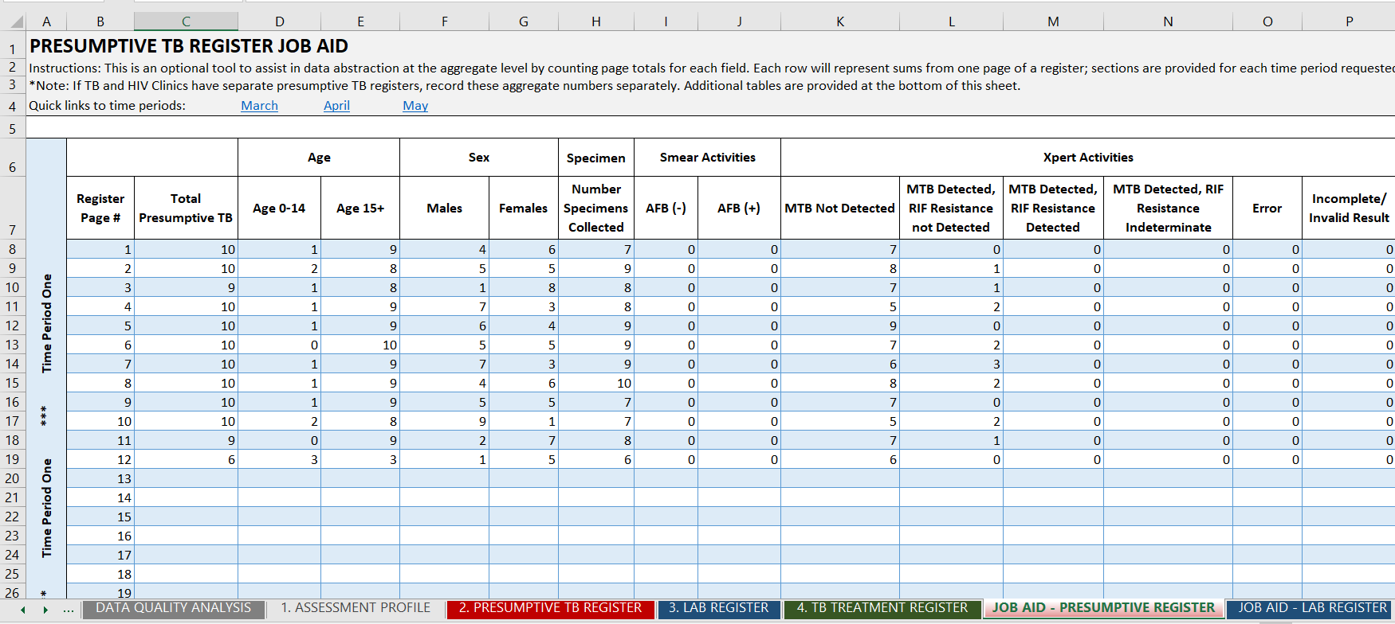
DiCE Toolkit Adaptation and Use
Job aid tabs capture necessary steps of the cascade but can be customized to include specific language/appropriate order of the fields in the available data sources for ease of use.

Slide 12
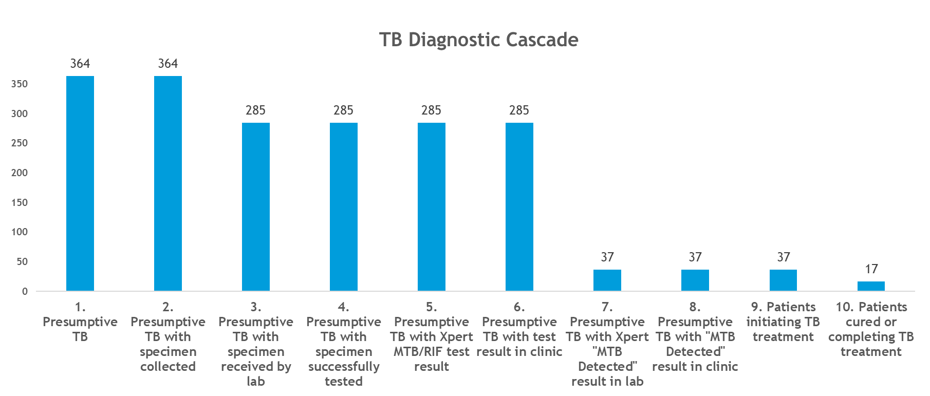
DiCE Toolkit – Example Cascade Analysis
Once the job aids are filled in for a designated period, data from various sources then auto-populates to create a cascade, where gaps can be visualized.

Slide 13
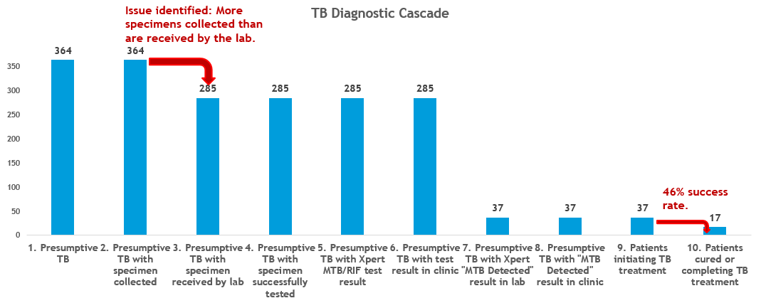
DiCE Toolkit – Example Cascade Analysis

Slide 14
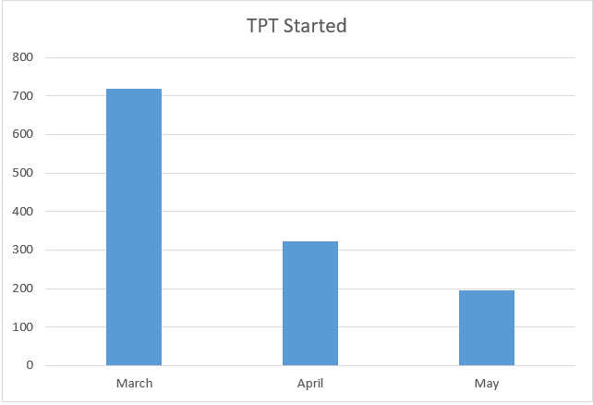
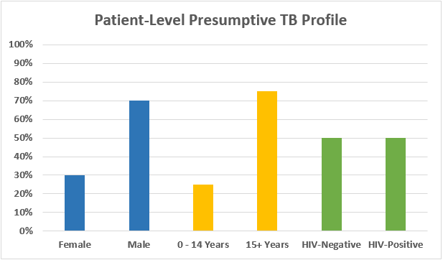
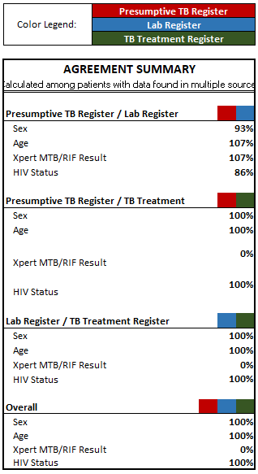
DiCE Toolkit – Additional Outputs
1. 2. 3.
4.

Slide 15
Part Two: DiCE Entry Assessment Practical Considerations
Entry DiCE Assessment Teams
Select members for assessment team and relevant stakeholders (e.g., national, sub-national and/or partner staff)
Determine who the site points-of-contact are and request them to be available
- To provide facility walkthrough (patient and data flow)
- To gather registers for data collection
- To answer questions during the assessment
Inconsistencies or challenges with data will be resolved on-site
Entry DiCE Assessment Logistics
Assessment time = 1 day per site(s)
Site Department POCs: HIV Clinic, TB Clinic and TB Lab (on-site and/or referral) at one facility

Slide 16
Data Collection and Quality
Project personnel that collect data will be trained and competent
Aggregate data collected from paper registers
Will include redundant data points as an internal quality check
All data challenges and inconsistencies will be resolved prior to leaving facility
DiCE completeness will be cross-checked prior to leaving facility
Missing or unavailable data will be recorded as “MISSING”
Patient data (no PII) from same registers as aggregate data
Randomly selected patients from Presumptive TB register
5% of Presumptive TB register, up to a maximum of 20
Half will be HIV (+) and half will be HIV (-) to prevent non-random selection

Slide 17
Data Collection and Quality Continued
DiCE Quality Analysis
Automatic calculation of agreement between data sources and completeness of registers
CLICQ! Metric Data
Recorded by site staff using site-specific metrics and tracking plans and quality reviewed during on-site visits

Slide 18
Part Three: CLICQ! Implementation
After site entry assessment, the CLICQ! program begins
Two facility-based learning sessions (~30 days apart) with all participants
Learning Session 1 (1 week)
DiCE findings reviewed
Identified gaps prioritized
Development of improvement projects and metrics to close gaps
- Learning session facilitators will assist facility staff in choosing projects and
metrics to track progress

Slide 19
Part Three: CLICQ! Implementation Continued
Improvement Project Metrics
Selected metrics (numerator / denominator) will be collected at least weekly by facility staff participating in CLICQ!
Learning Session 2 (1 week)
Improvement project review / course corrections / additional training
On-site TA
Provided by those responsible for oversight of the facility, led by MOH or similar
Occurs between the two learning sessions
Every 1 – 2 weeks
Remote TA using WhatsApp or other electronic solutions may be preferable

Slide 20
CLICQ! Implementation Timeline
NOTE: timeline estimates are only examples and can be modified depending on local context (e.g., program needs, available budget, and available expertise, etc.)

Slide 21
Part Four: DiCE Follow-up Assessment and Program Impact
Each enrolled facility will receive a DiCE follow-up assessment
Follow-up assessments will be directly compared to entry assessments
CLICQ! project impact will be quantified
Review lessons learned, successes, challenges
- Partner facilitators conduct this session with facility staff
Stakeholder closeout

Slide 22
Part Five: Program Impact / Writing Workshop
Program Impact will be evaluated by a few different analyses
Improvement project metric data tracked over the implementation period
Comparison of the DiCE entry and follow-up assessments
Participant discussion of lessons learned, challenges and successes
Optional Writing Workshop
Site staff will present final data, achievements, and challenges
Breakout groups will draft section of the final report
Discussion of expectations for data sharing, reporting, future
publications, CLICQ! sustainability, and potential CLICQ! scale-up

Slide 23
Data Sharing and Reporting
Data will be owned by the MOH (or relevant disease program stakeholders)
De-identified DiCE and site metric data will be provided to stakeholders after each workshop
and each DiCE assessment
Results and recommendations will be made available to the following
Participating facilities, NTP, SMoH, Partner, Funding Agency, US CDC
Results will be in the form of reports, Excel spreadsheets, data tools, and PowerPoint presentations
Confidentiality
No PII will be collected
Project staff will be instructed to protect the privacy of all patient data encountered during
data collection

Slide 24
Protocol Discussion Outline
Review protocol for:
Sections / content required for a CDC protocol
Sections / content required for a (*state, province Country*) protocol
Proposed sections
Program Background and Justification
Goals
Objectives
Project Design
Region, State, province selection
Site selections

Slide 25
Roles and Responsibilities
Organization | Name | Role
(*complete*) See examples below | (*complete*) See examples below | (*complete*) See examples below
Federal Ministry of Health | John Doe | Principal investigator
---- | ---- | Co-investigator
---- | ----
---- | ----
---- | ----
---- | ----
---- | ----
---- | ----
---- | ----
---- | ----
---- | ----
---- | ----
CLICQ!
Partnership with FMoH and SMoH
(*Donor/funding source*) provides funding support and partner
oversight
(*MOH/Partner*) provides on-the-ground implementation of CLICQ!
(*MOH/Partner*) provide technical support
Facility support from healthcare workers and technicians
Principal Investigator: Leads protocol development, ethical clearance and tool development; provides oversight for project implementation, data analysis and project evaluation; participates in report/ manuscript development; assists with dissemination of findings.
Co-Investigator: Technical input on protocol development, tool development, project implementation, data analysis, project evaluation; participate in report/ manuscript development; assist with dissemination of findings.

Slide 26
Roles and Responsibilities by Activity
Organization | Name | DiCE Assessments | Learning Session 1 | Learning Session 2 | On-Site TA / Monitoring | Close-Out / Writing Workshop
(*complete*) See example below | (*complete*) See example below | (*complete*) See example below | (*complete*) See example below | (*complete*) See example below | (*complete*) See example below | (*complete*) See example below
Federal Ministry of Health | John Doe |  | X | X |  | X
Partner | Wendy Smith | X | X | X | X | X
National HIV Program | Jimmy Park | X |  |  | X | X
National TB Program | Suzie Q |  | X | X |  | X
(*ADD ROWS AND NAMES OF PARTICIPANTS AS NECESSARY TO COMPLETE*)

Slide 27
SITE SELECTION GENERAL CRITERIA

Slide 28
Selection Criteria for Region, State, Province
High burden of TB/HIV disease
Ease of access (infrastructure, security, political stability)

Slide 29
SITE SELECTION METHODS

Slide 30
Selection Criteria for Clinic and Laboratory Sites
High burden(s) of disease (e.g., TB, TB/HIV, pediatric TB and/or DR TB patients)
This will maximize opportunities to identify gaps within the diagnostic cascade(s) at participating clinics and labs
Ease of Access to ensure CLICQ! program participants are able to carry out related activities
Infrastructure: well-constructed, easily navigable roads
Security: Access routes and site locations are secure and safe for CLICQ! participants
Political stability: Avoid areas that pose an unacceptable risk to CLICQ! participants
Clinics and labs are purposefully selected while considering the following criteria:
Target TB population: determine the specific objectives of CLICQ! customization (e.g., DR TB, pediatric TB, HIV-associated TB)
TB patient volumes: high volume sites may impact greater numbers of patients in need, while lower volume sites may serve specific risk groups of interest or with little access to lab services.
On site versus referral lab services for initial molecular WHO-recommended rapid diagnostic (mWRD) testing. This can capture differences in the clinic-lab interface associated with patient and/or specimen referral
Site-to-site proximity: proximity enhances cross-facility sharing of lessons learned, logistics of conducting DiCE assessments and mentorship communication.
Practical knowledge: MOH or local staff may provide details that include sites with known diagnostic gaps or sites already receiving strengthening activities

Slide 31
Site Selection Methods
Compile a spreadsheet of all potential clinics and laboratories in selected region
Begin limiting sites based upon the following metrics:
Sites reporting: Positive TB symptom screens AND treatment initiations > 0
Sites should ideally be within ~2hr drive from base/hotel (use ArcGIS or Google Maps)
Sites should be comprised of both on-site and referral TB diagnostic testing

Slide 32
Semi-Final Site Selection
(*Add the SEMI-FINAL compiled list of sites to this slide*)
Allow relevant stakeholders (FMoH, SMoH, etc.) to
provide input in making the final site selections

Slide 33
Region/State: Site Selection Final List
NAME OF FACILITY | CITY / TOWN | ON-SITE / REFERRAL DIAGNOSTIC TESTING
1.
2.
3.
4.
5.

Slide 34
Questions?

